Slide 1

Cryptography and Encryption Techniques

Slide 2
Terminologies
Cryptography: Schemes for encryption and decryption
Encryption algorithm: technique or rules selected for encryption.
Key: is secret value used to encrypt and/or decrypt the text.
Cryptanalysis: The study of “breaking the code”.
Cryptology: Cryptography and cryptanalysis together constitute the area of cryptology.

Slide 3
Introduction
What is cryptography ?
Cryptography is the study of Encryption
  Greek kryptos means “hidden” and graphia means “writtings”
Encryption is an ancient form of information protection. … dates back 4,000 years.
  process by which plaintext is converted into ciphertext.
Decryption is the inverse of Encryption.

Slide 4
Introduction ….
Cryptography has five components:
    Plaintext: This is what you want to encrypt.
    Ciphertext: The encrypted output.
    Enciphering or encryption: The process by which plaintext is converted into ciphertext.
    Encryption algorithm: The sequence of data processing steps that go into transforming plaintext into ciphertext.
    Secret Key: is used to set some or all of the various parameters used by the encryption and decryption algorithm.
    Deciphering or decryption: Recovering plaintext from ciphertext.
    Decryption algorithm: The sequence of data processing steps that go into transforming ciphertext back into plaintext.
Security depends on the secrecy of the key, not the secrecy of the algorithm

Slide 5
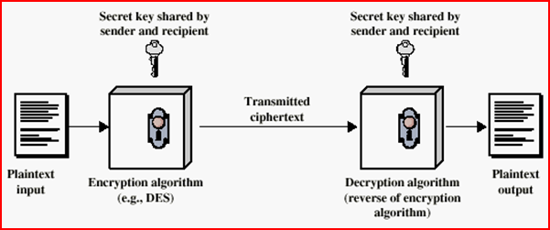
Introduction ….
Simplified Encryption Model:

Slide 6
Introduction …
A sender S wanting to transmit message M to a receiver R
To protect the message M, the sender first encrypts it into meaningless message M’
After receipt of M’, R decrypts the message to obtain M
M is called the plaintext
  What we want to encrypt
M’ is called the ciphertext
  The encrypted output

Slide 7
Introduction…
Notation
Given
    P=Plaintext
    C=CipherText
C = E_{K} (P) Encryption
P = D_{K} ( C) Decryption

Slide 8
Services Provided by Cryptography
Confidentiality
  provides privacy for messages and stored data by hiding
Message Integrity
  provides assurance to all parties that a message remains unchanged
Non-repudiation
  Can prove a document came from the intended user
Authentication
  identifies the origin of a message
  verifies the identity of person using a computer system

Slide 9
Cipher Techniques
Transposition Cipher Vs Substitution Cipher

Slide 10
Building Blocks of Encryption Techniques
Two building blocks of all classical encryption techniques are
substitution and transposition.
Substitution means replacing an element of the plaintext with an element of ciphertext.
  each element in the plaintext (bit, letter, group of bits or letters) is mapped into another element
Transposition means rearranging the order of appearance of the elements of the plaintext.
Transposition is also referred to as permutation.

Slide 11
Substitution Cipher
Types of Substitution cipher:
  Monoalphabetic Cipher
  Caesar Cipher
  Modified Caesar Cipher
  Polygram Cipher
  Playfair cipher
  Polyalphabetic ciphers
    Vigenere cipher
    One-time pad

Slide 12
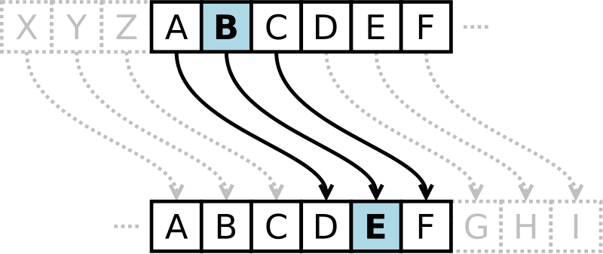
Caesar Cipher Substitution
Caesar Cipher is used by Julius Caesar's military
  substitutes each letter of the alphabet with the letter standing three places further down the alphabet

Slide 13
Activity
Convert it ....to Caesar Ciphertext?
  Plaintext: are you ready
  Ciphertext: duh brx uhdgb
Plaintext
a | b | c | d | e | f | g | h | i | j | k | l | m | n | o | p | q | r | s | t | u | v | w | x | y
D | E | F | G | H | I | J | K | L | M | N | O | P | Q | R | S | T | U | V | W | X | Y | Z | A | B
z
C
Ciphertext

Slide 14

Caesar Cipher
The algorithm can be expressed as, for each plaintext letter P, substitute ciphertext letter C.
  C = E(3, p) = (p + 3) mod 26
Mathematically give each letter a number
General Caesar algorithm as:
  c = E(k, p) = (p + k) mod (26)
  p = D(k, c) = (c – k) mod (26)
Where k is [1 to 26]. Secret-key

Slide 15
Modified Caesar Cipher
In this version of Caesar cipher, the cipher text alphabets corresponding to the original plain text alphabets may not necessarily be three places down the order, but instead, can be any places down the order
  First we must translate our message into our numerical alphabet
  Choose the number you want to shift by
  Then we add the B-shift to each number
  E.g 1. The name 'James' encrypted with a B-shift of 7 is:
        J = 9 + 7 = 16
        A = 0 + 7 = 7
        M = 12 + 7 = 19
        E = 4 + 7 = 11
        S = 18 + 7 = 25
    16 = Q, 7 = H, 19 = T, 11= L, 25 = Z.
      QH T L Z

Slide 16
Modified Caesar Cipher
  E.g.2. The phrase 'is a spy' using the same B-shift.
      I = 8 + 7 = 15,
      S = 18 + 7 = 25
      A = 0 + 7 = 7
      S = 18 + 7 = 25
      P = 15 + 7 = 22
      Y = 24 + 7 = 31
  So 15 is P, 25 is Z, 7 is H, 25 is Z again, and 22 is W, but what is 31?
  Use mod 26
  Since, 31 mod 26 = 5, which corresponds to F
  So “is a spy” = PZHZWF

Slide 17
Modified Caesar Cipher
In order for someone to translate the message, they would have to use our cipher backwards.
  PZHZWF -> is a spy
  So first they would translate the letters into numbers again
  In order to solve the cipher they would also need to know that we used a B-shift of 7, then we would need to subtract.
  Since 15- 7 which is I , 25 – 7 which is S, So on …..
  But, F becomes 5, 5 minus 7 is negative 2?
    Reverse the 'mod 26' calculation
  Negative 2 plus 26 is 24, which translates to Y

Slide 18
Monoalphabetic Cipher
Rather than just shifting the alphabet could shuffle (jumble) the letters arbitrarily each plaintext letter maps to a different random ciphertext letter. Hence, key is 26 letters long
  Plain: abcdefghijklmnopqrstuvwxyz
  Cipher: DKVQFIBJWPESCXHTMYAUOLRGZN
  Plaintext: ifwewishtoreplaceletters
  Ciphertext:WIRFRWAJUHYFTSDVFSFUUFYA

Slide 19
Polygram Cipher
In Polygram substitution cipher technique, rather than replacing one plain text alphabet with one cipher text alphabet at a time, a block of alphabets is replaced with another block.
  For instance, HELLO could be replaced by YUQQW, but HELL could be replaced by a totally different cipher text block TEUI
  The replacement of plain text happens block by block, rather than character by character

Slide 20
Playfair Cipher
A manual symmetric encryption technique
It was the first literal digraph substitution cipher.
  The scheme was invented in 1854 by Charles Wheatstone, but bears the name of Lord Playfair who promoted the use of the cipher.
Used in WWI and WWII

Slide 21
Playfair Key Matrix
a 5X5 matrix of letters based on a keyword
fill in letters of keyword (no duplicates, i & j)
fill rest of matrix with other letters
E g. using the keyword (key) simple
s | i/j | m | p | l
e | a | b | c | d
f | g | h | k | n
o | q | r | t | u
v | w | x | y | z

Slide 22
Playfair Cipher
Use filler letter to separate repeated letters
  eg. "balloon" encrypts as "ba lx lo on" Encrypt two letters together
If both the letters are in the same row: Take the letter to the right of each one (going back to the leftmost if at the rightmost position).
ac--bd
If both the letters are in the same column: Take the letter below each one (going back to the top if at the bottom).
gk--hn
If neither of the above rules is true: Form a rectangle with the two letters and take the letters on the horizontal opposite corner of the rectangle.
ar--bq

Slide 23
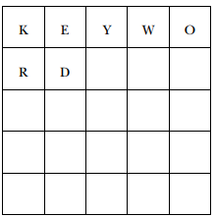
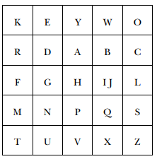
Activity 1
Eg. Keyword. Now write the letters keyword in the first squares of a five by five matrix:
Then finish filling up the remaining squares of the matrix with the remaining letters of the alphabet, in alphabetical order
For example, the sentence “Why, don’t you?” becomes
  WH YD ON TY OU
  Ciphertext :YI EA ES VK EZ

Slide 24
Activity2
instruments
Q: construct the playfair matrix using the keyword MONARCHY ?
Plaintext: Ethiopia
Ciphertext:
Would you pleas tray this: “instruments” with the above keyword
M | O | N | A | R
C | H | Y | B | D
E | F | G | I/J | K
L | P | Q | S | T
U | V | W | X | Z
klbfhvsb

Slide 25
Polyalphabetic ciphers
Using multiple substitution alphabets.
Make cryptanalysis harder with more alphabets to guess and flatter frequency distribution
Use a key to select which alphabet is used for each letter of the message
  Use each alphabet in turn
  Repeat from start after end of key is reached

Slide 26
Vigenere Cipher
Simplest Polyalphabetic substitution cipher
Meaning that instead of there being a one-to-one relationship between each letter and its substitute, there is a one-to-many relationship between each letter and its substitutes.
  The encipherer chooses a keyword and repeats it until it matches the length of the plaintext

Slide 27
Vigenere Cipher
write the plaintext out
write the keyword repeated above it
use each key letter as a caesar cipher key
encrypt the corresponding plaintext letter

Slide 28
Activity
Q: encrypt the given plaintext letter using Vigenère Cipher, use keyword deceptive
  plaintext: wearediscoveredsaveyourself
  Key: deceptivedeceptivedeceptive
  Ciphertext: zicvtwqngrzgvtwavzhcqyglmgj

Slide 29
Transposition Cipher
Transposition ciphers differ form substitution cipher technique in addition to replace on alphabet with another they perform some permutation over the plain text alphabet
Rearrange bits or characters in the data
  Letters stay the same
  Order is different

Slide 30
Transposition Cipher
Types of Transposition Cipher Techniques:
  Spartans cipher
  Rail fence cipher
  Simple Columnar Transposition
  Route cipher
  Book cipher/running key cipher

Slide 31
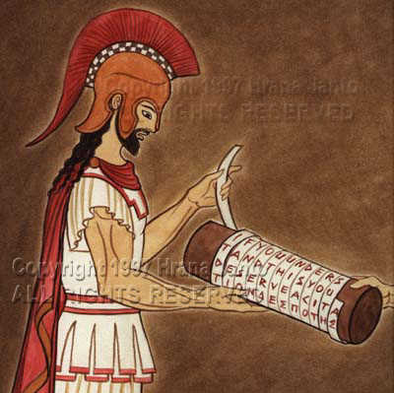
Classical Transposition
Spartans cipher , fifth century B.C.
Start the war today
Rewrite it by reading down
Srhaoytterdatwta
Encryption: rearrange the text in 3 columns
S t a
r t t
h e w
a r t
o d a
y

Slide 32
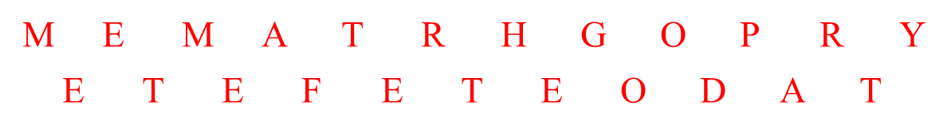

Rail Fence
  The simplest of such ciphers is the rail fence technique, in which the plaintext is written down as a sequence of diagonals and then read off as a sequence of rows
  For example, to encipher the message “MEET ME AFTER THE GOOD PARTY” with a rail fence of depth 2 (number of rows, which is the key), we write the following
    The ciphertext is MEMATRHGOPRYETEFETEODAT
    With depth of 3

Slide 33
Columnar Transposition
Write the message in rows of a fixed length, and then read out again column by column. The columns are chosen in some scrambled order. Both the length of the rows and the permutation of the columns are usually defined by a keyword.

Slide 34
Key Columnar Transposition
Example: Let the key word be: ZEBRA.
The message:
EODAEASRENEIELORCEECWDVFT.
Z | E | B | R | A
W | E | A | R | E
D | I | S | C | O
V | E | R | E | D
F | L | E | E | A
T | O | N | C | E

Slide 35
Route Cipher
The plaintext is first written out in a grid of given dimensions, then we read it off in a pattern given in the key.
Example: The key say: read message from top right corner down and to the left.
The message:
TONCEADOEFLEEECRVERSADIEW.
W | D | V | F | T
E | I | E | L | O
A | S | R | E | N
R | C | E | E | C
E | O | D | A | E

Slide 36
Cryptanalysis
KIBRU Loved(Fourth Years Female)

Slide 37
Cryptanalysis
Types of attacks encryption
  The attacker has only the ciphertext and his/her goal is to find the corresponding plaintext
  The attacker has a ciphertext and the corresponding plaintext and his/her goal is to find the key
A good cryptosystem protects against all types of attacks

Slide 38
Cryptanalysis
general approaches:
  Cryptanalytic attack
    exploits the characteristics of the algorithm
  Brute-force attack
    try every possible key on a piece of cipher text
  Letter frequency analysis attack
Objective to recover key not just message

Slide 39
Cryptanalytic Attacks
Ciphertext only
  Only know algorithm & ciphertext, is statistical, know or can identify plaintext .
  Find the plain text of the message or the key. Most difficult
Known plaintext
  Know/suspect plaintext & ciphertext
  Find key or algorithm
Chosen plaintext
  select plaintext and obtain ciphertext
Chosen ciphertext
  select ciphertext and obtain plaintext
Chosen text
  select plaintext or ciphertext to en/decrypt

Slide 40
Cryptanalysis…
given a ciphertext Caesar cipher, then a brute-force is easy performed:
  simply try all the 25 possible keys.
  Assuming language of the plaintext is known.
Thus, Caesar cipher is far from secure.
  Eg: try to break this Caesar cipher
  BRXDUHKDFNLQJ

Slide 41
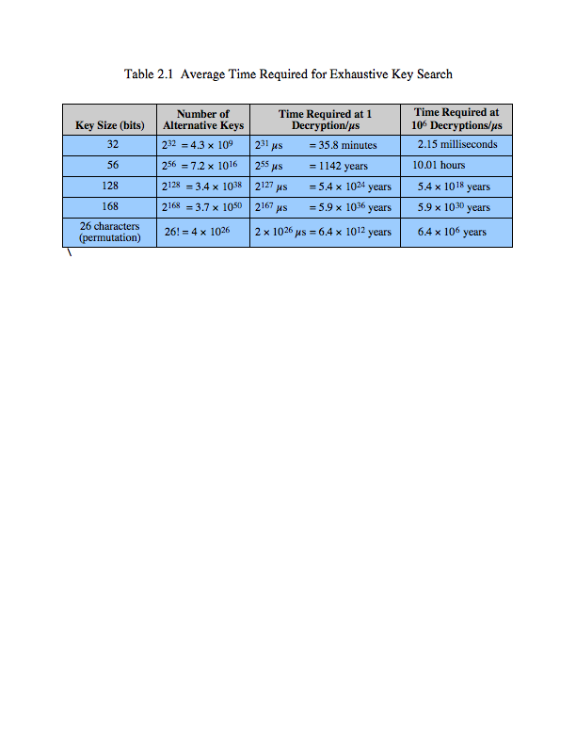
Brute Force Search
always possible to simply try every key
assume either know / recognise plaintext
impractical if we use an algorithm that employs a large number of keys.
most basic attack, proportional to key size

Slide 42
Language Redundancy and Cryptanalysis
Human languages are redundant
Letters are not equally commonly used
In English E is by far the most common letter
  followed by T,R,N,I,O,A,S
Other letters like Z,J,K,Q,X are fairly rare
Have tables of single, double & triple letter frequencies for various languages

Slide 43
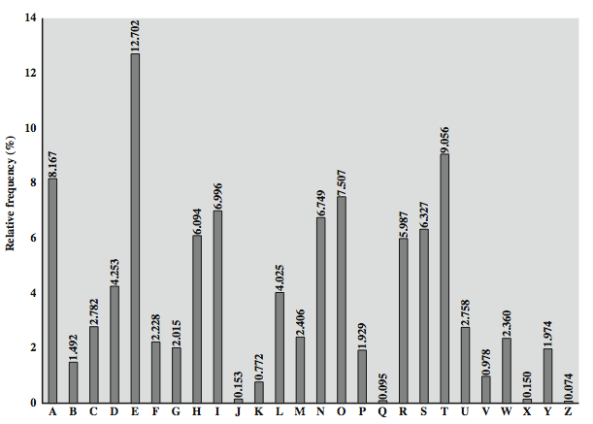
English Letter Frequencies

Slide 44
More Definitions
Unconditional security
  No matter how much computer power or time is available, the cipher cannot be broken since the ciphertext provides insufficient information to uniquely determine the corresponding plaintext
Computational security
  Given limited computing resources (eg time needed for calculations is greater than age of universe), the cipher cannot be broken
  It either takes too long, or is too expensive,

Slide 45
Cryptographic Systems
  Private key (Symmetric key), Public key (Asymmetric key)

Slide 46
Cryptographic systems
Characterized along three dimensions:
operations used for transforming
  Substitution: Replace (bit, letter, group of bits letters
  Transposition: Rearrange the order
  Product :use multiple stages of both
number of keys used
  Symmetric: same key , secret-key, private-key
  Asymmetric: different key , public-key
way in which the plaintext is processed
  block cipher
  Stream cipher

Slide 47
Cryptographic Systems
There are two fundamentally different cryptographic systems
  Symmetric cryptosystem/ Private key
  Asymmetric cryptosystem/ Public key
Symmetric: the same key is used to encrypt the data
  Both sides of the communication must have the same key
  Examples: DES, AES, Blowfish, RC2, RC5, IDEA…
Asymmetric: different keys are used to encrypt and decrypt the data
  Example: RSA,DH, Elgamal…

Slide 48


K₁
K₂
Encryption
Decryption
M
C
M
More formally, using maths:
Notation
  Plain text: M
  Encrypted text: C
  Encryption with key K₁ : E _{K1}(M) = C
  Decryption with key K₂ : D _{K2}(C) = M
Algorithms
  Symmetric: K₁ = K₂
  Asymmetric: K₁ ≠ K₂

Slide 49
Symmetric ciphering
Also called secret-key/private-key cryptosystem
The same key is used to encrypt and decrypt a message
  C = D_{K} [E_{K} (P)]
Have been used for centuries in a variety of forms
The key has to be kept secret
The key has to be communicated using a secure channel
They are still in use in combination with public-key cryptosystems due to some of their advantages

Slide 50
Requirements
Two requirements for secure use of symmetric encryption:
  a strong encryption algorithm
  a secret key known only to sender / receiver
mathematically have:
  C = E(K, P ) done by sender side
  P = D(K, C ) receiver side
Assume encryption algorithm is known
implies a secure channel to distribute key

Slide 51
Asymmetric ciphering
Asymmetric Cryptography
Also called public-key cryptosystem
  keys for encryption and decryption are different but form a unique pair
  C = D_{KD} [E_{KE} (P)]
  Only one of the keys need to be private while the other can be public.
Invented by Diffie and Hellman in 1976.
It is a revolutionary concept since it avoids the need of using a secure channel to communicate the key.
It has made cryptography available for the general public and made many of today’s on-line application feasible.

Slide 52
Block vs Stream Ciphers
Block ciphers process messages into blocks, each of which is then en/decrypted
like a substitution on very big characters
  64-bits or more
Stream ciphers process messages a bit or byte at a time when en/decrypting
many current ciphers are block ciphers

Slide 53
Substitution-Permutation Ciphers…
Substitution Operation
  a binary word is replaced by some other binary word
  the whole substitution function forms the key
  if use n bit words, the key is 2^{n} ! bits, grows rapidly
  will call them S-Boxes
Permutation Operation
  a binary word has its bits reordered (permuted)
  the re-ordering forms the key
  if use n bit words, the key is n! bits, which grows more slowly, and hence is less secure than substitution
  will call these P-Boxes

Slide 54
Substitution-Permutation Ciphers…
In cryptography, confusion and diffusion are two properties of the operation of a secure cipher which were identified by Shannon.
Shannon's mixing transformations are a special form of product ciphers where
S-Boxes
  provide confusion of input bits
    Making the relationship between the key and the ciphertext as complex and involved as possible
P-Boxes
  provide diffusion across S-box inputs
    It hides the relationship between the ciphertext and the plaintext
      The property that redundancy in the statistics of the plaintext is "dissipated" in the statistics of the ciphertext

Slide 55
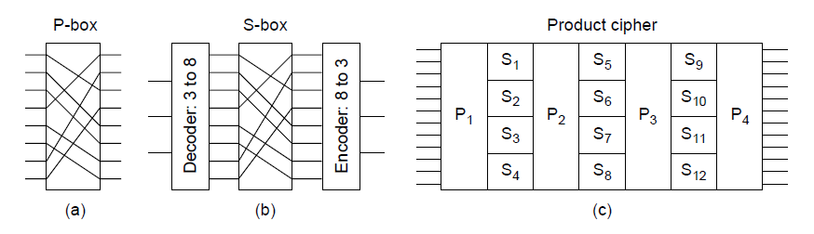
Substitution-Permutation Ciphers…
Basic elements of product ciphers.
(a) P-box. (b) S-box. (c) Product.

Slide 56
Cryptographic Algorithms
  Block ciphers (secret/symmetric key, DES)
  Hashes (digital signature)
  Diffie-Hellman key exchange
  RSA (public key encryption and digital signature)
  ElGamal digital signature
  IDEA, RC2, RC5, Blowfish, and many more

Slide 57
Symmetric Block Cipher Algorithms
  DES (Data Encryption Standard)
  3DES (Triple DES)
  AES (Advanced Encryption Standard)

Slide 58
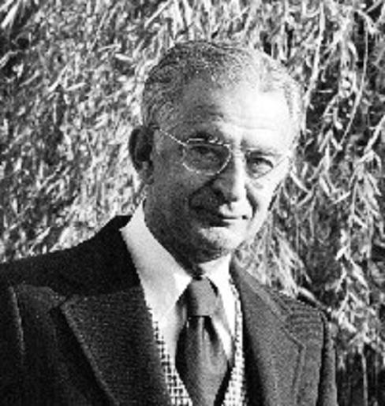
Feistel Cipher Structure
It is block cipher symmetric encryption algorithms, first described by Horst Feistel of IBM in 1973.
It is depends on the choice of the following parameters
  Block size: larger block sizes mean greater security
  Key Size: larger key size means greater security
  Number of rounds: multiple rounds offer increasing security
  Subkey generation algorithm: greater complexcity will lead to greater difficulty of cryptanalysis.
  Fast software encryption/decryption: the speed of execution of the algorithm becomes a concern.

Slide 59
Feistel Cipher Structure
Steps:
Input of plaintext and key K.
Plaintext is divided into two halves L0 and R0.
These two halves pass through N round of processing to produce CipherText block.
The key K is derived from subkey generation algorism .
These two halves combine by applying a round function ‘F’ on right half of data and then taking
X-OR operation of the output of F with left half of data.

Slide 60
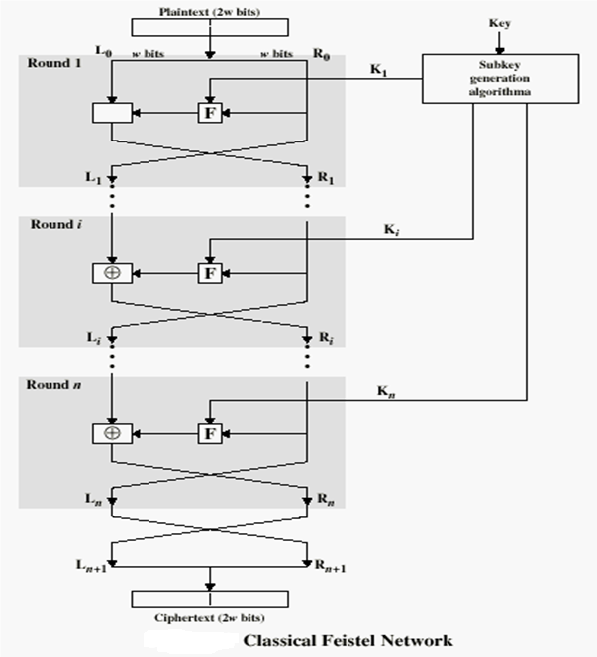

Slide 61
Data Encryption Standard (DES)
Most widely used block cipher in world
Adopted in 1977 by NBS (now NIST)
  NBS-National Bureau of Standards
  NIST - National Institute of Standards and Technology
Encrypts 64-bit data using 56-bit key
Has widespread use
Has been considerable controversy over its security

Slide 62
Symmetric DES…
The basic process in enciphering a 64-bit data block using the DES consists of:
  an initial permutation (IP)
  16 rounds of a complex key dependent calculation f
  a final permutation, being the inverse of IP

Slide 63
Symmetric DES...
DES Utilizes block cipher.
  During the encryption process, the plaintext is divided into fixed length blocks of 64 bits.
The key is 56 bits wide. 8-bit out of the total 64-bit block key is used for parity check.
56-bit key gives 2⁵⁶ (≅ 7.2*10¹⁶) possible key variations.
DES algorithm involves carrying out combinations of substitutions and permutations between the text to be encrypted and the key,
  while making sure the operations can be performed in both directions (for decryption).

Slide 64
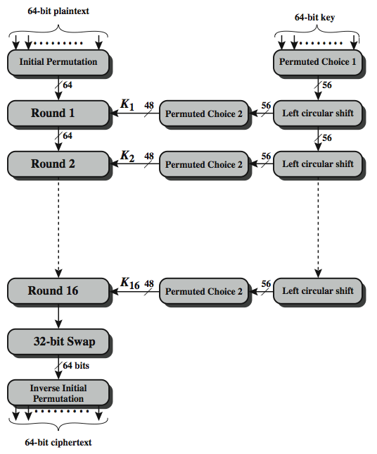
DES Encryption Overview

Slide 65
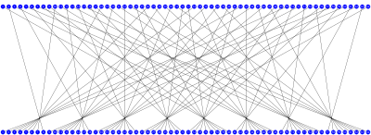
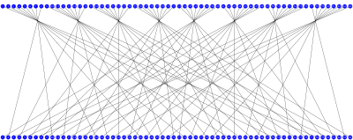
Symmetric DES
It reorders the input data bits
Initial Permutation (IP)
Final Permutation (FP)
IP
58 | 50 | 42 | 34 | 26 | 18 | 10 | 2
60 | 52 | 44 | 36 | 28 | 20 | 12 | 4
62 | 54 | 46 | 38 | 30 | 22 | 14 | 6
64 | 56 | 48 | 40 | 32 | 24 | 16 | 8
57 | 49 | 41 | 33 | 25 | 17 | 9 | 1
59 | 51 | 43 | 35 | 27 | 19 | 11 | 3
61 | 53 | 45 | 37 | 29 | 21 | 13 | 5
63 | 55 | 47 | 39 | 31 | 23 | 15 | 7
IP⁻¹
40 | 8 | 48 | 16 | 56 | 24 | 64 | 32
39 | 7 | 47 | 15 | 55 | 23 | 63 | 31
38 | 6 | 46 | 14 | 54 | 22 | 62 | 30
37 | 5 | 45 | 13 | 53 | 21 | 61 | 29
36 | 4 | 44 | 12 | 52 | 20 | 60 | 28
35 | 3 | 43 | 11 | 51 | 19 | 59 | 27
34 | 2 | 42 | 10 | 50 | 18 | 58 | 26
33 | 1 | 41 | 9 | 49 | 17 | 57 | 25
“First Bit of the output is taken from the 58th bit of the input, etc...”

Slide 66
Symmetric DES...
DES Encryption starts with an initial permutation (IP) of the 64 input bits.
These bits are then divided into two 32-bit halves called L and R.
The encryption then proceeds through 16 rounds, each using the L and R parts, and a roundkey.
The R and roundkeys are processed in the so called f-function, and exclusive-or of the output of the f-function with the existing L part to create the new R part.
The new L part is simply a copy of the incoming R part.

Slide 67
Symmetric DES...
In the final round, the L and R parts are swapped once more before the final permutation (FP) producing the output block.
Decryption is identical to encryption, except that the subkeys are used in the opposite order.
That is, roundkey 16 is used in round 1, roundkey 15 is used in round 2, etc., ending with roundkey 1 being used in round 16.
The f-function mixes the bits of the R portion using the roundkey for the current round.

Slide 68
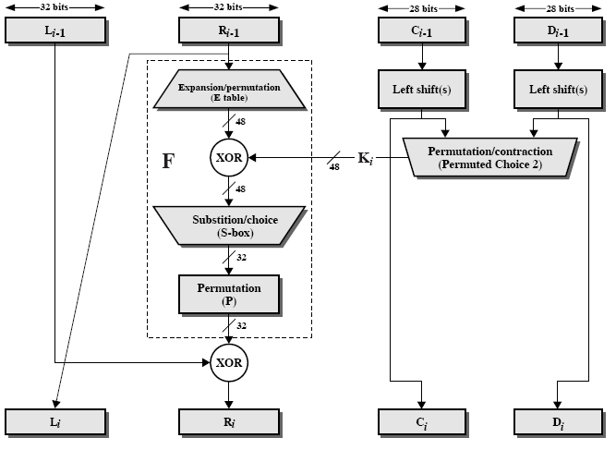
One Round of DES Algorithm

Slide 69
One Round of Processing in DEA
The 32-bit right half of the 64-bit input data block is expanded by into a 48-bit block.
This is referred to as the expansion permutation step, or the E-step.
The E-step involves the following:
  attach an additional bit on the left to each 4-bit word that is the last bit of the previous 4-bit word
  attach an additional bit to the right of each 4-bit word that is the beginning bit of the next 4-bit word.
The 56-bit key is divided into two halves,
  each half shifted separately, and the combined 56-bit key permuted/contracted to yield a 48-bit round key.

Slide 70
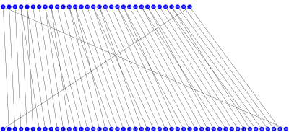
DES Expansion Permutation
Input 32 bits
1 2 3 4 5 6 7 8 9 10
11 12 13 14 15 16 17 18
19 20 21 22 23 24 25 26 27
28 29 30 32
Output 48 bits
Expansion/Permutation
The 32-bit half-block of data is expanded to 48 bits.
E
32 | 1 | 2 | 3 | 4 | 5
4 | 5 | 6 | 7 | 8 | 9
8 | 9 | 10 | 11 | 12 | 13
12 | 13 | 14 | 15 | 16 | 17
16 | 17 | 18 | 19 | 20 | 21
20 | 21 | 22 | 23 | 24 | 25
24 | 25 | 26 | 27 | 28 | 29
28 | 29 | 30 | 31 | 32 | 1

Slide 71
One Round of Processing in DEA
The 48 bits of the expanded output produced by the E-step are XORed with the round key.
  This is referred to as key mixing.
The output produced by the previous step is broken into eight six-bit words.
Each six-bit word goes through a substitution step.
The substitution is carried out with an S-box.

Slide 72
The S-Box for the Substitution Step in Each Round
The 48-bit input word is divided into eight 6-bit words and each 6-bit word fed into a separate S-box.
Each S-box produces a 4-bit output. Therefore, the 8 S-boxes together generate a 32-bit output.
The overall substitution step takes the 48-bit input back to a 32-bit output.
Each of the eight S-boxes consists of a 4×16 table lookup for an output 4-bit word.
  The first and the last bit of the 6-bit input word are decoded into one of our rows and
  The middle 4 bits into one of 16 columns for the table lookup.

Slide 73
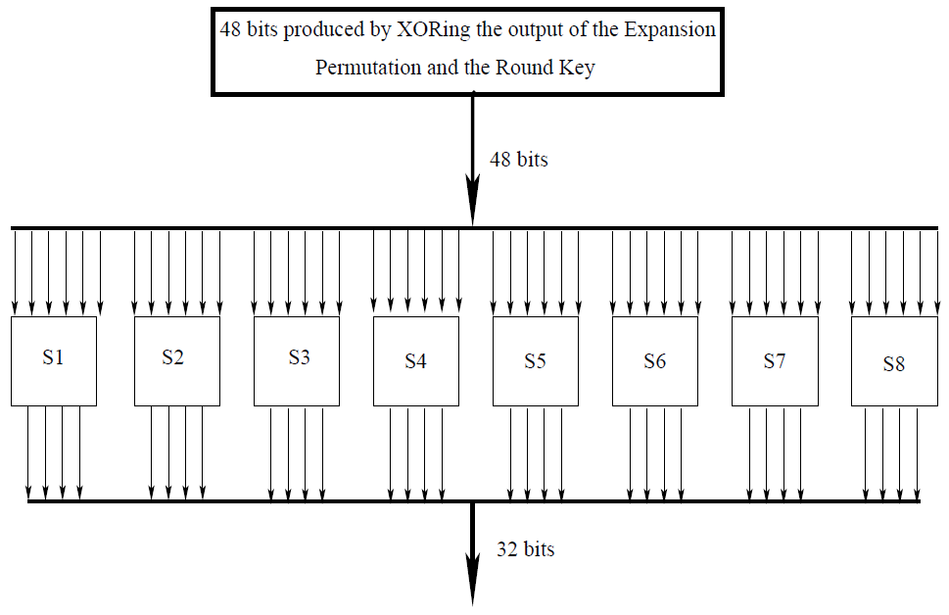
The S-Box for the Substitution Step in Each Round

Slide 74
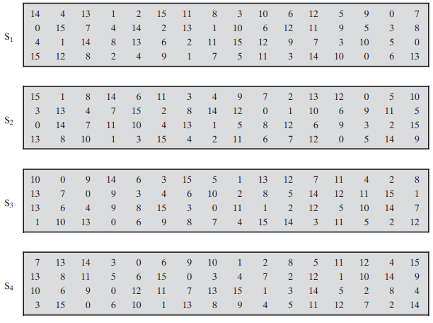
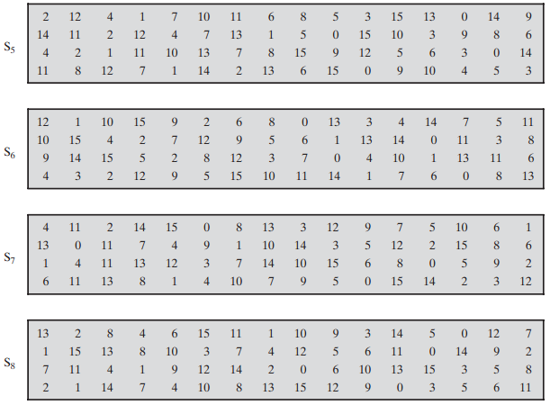
DES S-Boxes

Slide 75
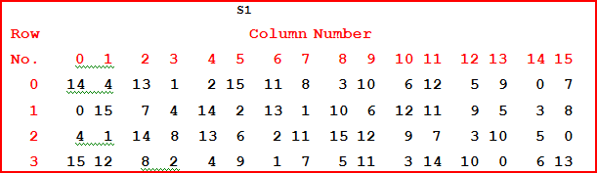
S-Box for the Substitution Step in Each Round
The S-Box
If S₁ is the function defined in this table and B is a block of 6 bits, then S₁(B) is determined as follows: The first and last bits of B represent in base 2 a number in the decimal range 0 to 3 (or binary 00 to 11). Let that number be i. The middle 4 bits of B represent in base 2 a number in the decimal range 0 to 15 (binary 0000 to 1111). Let that number be j. Look up in the table the number in the i-th row and j-th column. It is a number in the range 0 to 15 and is uniquely represented by a 4 bit block. That block is the output S₁(B) of S₁ for the input B. For example, for input block B = 011011 the first bit is "0" and the last bit "1" giving 01 as the row. This is row 1. The middle four bits are "1101". This is the binary equivalent of decimal 13, so the column is column number 13. In row 1, column 13 appears 5. This determines the output; 5 is binary 0101, so that the output is 0101. Hence S₁(011011) = 0101.

Slide 76
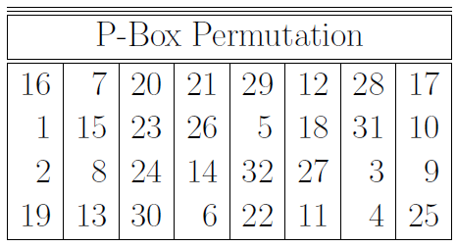
P-Box Permutation Step in Each Round
The 32-bits of the previous step then go through a P-box based permutation.
What comes out of the P-box is then XORed with the left half of the 64-bit block that we started out with.
The output of this XORing operation gives us the right half block for the next round.
The first output bit will be the 16th bit of the input, the second output bit the 7th bit of the input, and so on.

Slide 77
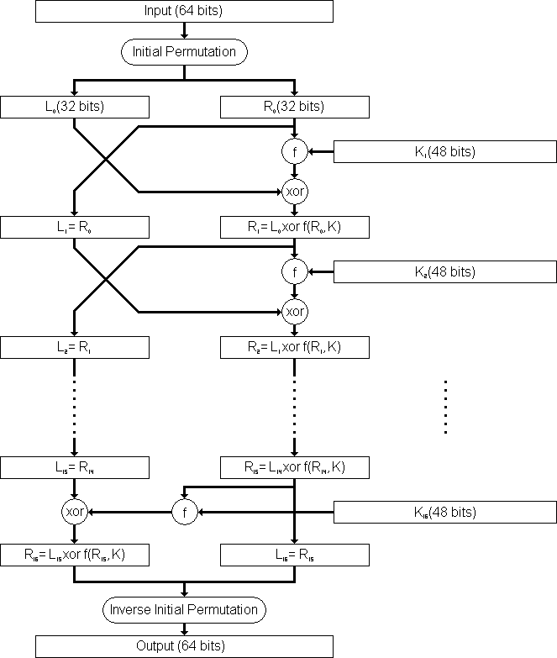
DES Round Structure
  L_{i} = R_{i–1}
  R_{i} = L_{i–1} ⊕ F(R_{i–1}, K_{i})

Slide 78
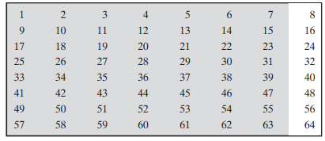
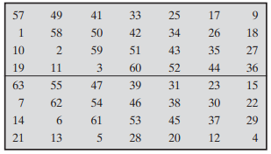
DES Round Key Generation
The initial 64-bit key may be represented as 8 bytes, with the last bit of each byte used as a parity bit.
The relevant 56 bits are subject to a permutation at the beginning before any round keys are generated. (permutation choice 1)
Initial Key
PC-1

Slide 79
DES Round Key Generation…
To generate the roundkeys, start with the 56-bit key (64 bits if you include the parity bits).
These are permuted and divided into two halves called C and D.
For each round, C and D are each shifted left circularly one or two bits.
Then Contraction/Permuted choice(PC-2)
  Remove 9 18 22 25 and 35 38 43 54 position bits
The 48-bit roundkey is then selected from the current C and D bits.

Slide 80

DES Round Key Generation….
Left Shift
Contraction/Permuted Choice (PC-2)
PC-2
14 | 17 | 11 | 24 | 1 | 5
3 | 28 | 15 | 6 | 21 | 10
23 | 19 | 12 | 4 | 26 | 8
16 | 7 | 27 | 20 | 13 | 2
41 | 52 | 31 | 37 | 47 | 55
30 | 40 | 51 | 45 | 33 | 48
44 | 49 | 39 | 56 | 34 | 53
46 | 42 | 50 | 36 | 29 | 32
Selects/Extracts the 48-bit subkey for each round from the 56-bit key-schedule state.

Slide 81
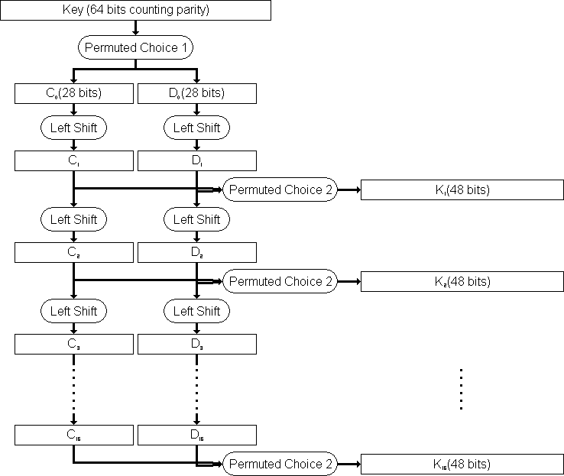
DES Round Key Generation…

Slide 82
One Round of Processing in DEA
The goal of the substitution step implemented by the S-box is to introduce diffusion in the generation of the output from the input.
  Diffusion means that each plaintext bit must affect as many ciphertext bits as possible.
The strategy used for creating the different round keys from the main key is meant to introduce confusion into the encryption process.
  Confusion in this context means that the relationship between the encryption key and the ciphertext must be as complex as possible.

Slide 83
Strength of DES – Key Size
56-bit keys have 2⁵⁶ = 7.2 x 10¹⁶ values
brute force search looks hard
recent advances have shown is possible
  in 1997 on Internet in a few months
  in 1998 on dedicated h/w (EFF) in a few days
  in 1999 above combined in 22hrs!
now considering alternatives to DES

Slide 84
Symmetric DES...
Cracking: The most basic method of attack for any cipher is brute force - trying every possible key in turn.
The length of the key determines the number of possible keys, and hence the feasibility of the approach.
DES is not adequate with this regard due to its key size
In academia, various proposals for a DES-cracking machine were advanced.
  In 1977, Diffie and Hellman proposed a machine, which could find a DES key in a single day.
  By 1993, Wiener had proposed a key-search machine costing US $1 million which would find a key within 7 hours.

Slide 85
Symmetric DES...
DES finally and definitively proved insecure in July 1998, when the Electronic Frontier Foundation (EFF) announced that it had broken a DES encryption using a special-purpose "DES cracker" machine that was built for less than $250,000.
The attack took less than three days.
The EFF has published a detailed description of the machine, enabling others to build their own cracker [EFF98].

Slide 86
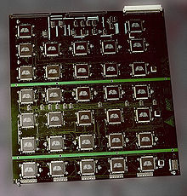
Symmetric DES...
The EFF's US$250,000 DES cracking machine contained 1,856 custom chips and could brute force a DES key in a matter of days.
The photo shows a DES Cracker circuit board fitted with several Deep Crack chips.

Slide 87
Multiple Encryption with DES for a More
Secure Cipher
As you already know, the DES cryptographic system was shown not to be very secure about 15 years ago.
We can obviously use AES cryptography that is designed to be extremely secure, but the world of commerce and finance does not want to give up on DES that quickly
  because of all the investment that has already been in DES-related software and hardware.
So that raises questions like: How about a cryptographic system that carries out repeated encryption with DES? Would that be more secure?
We will now show that whereas double DES may not be that much more secure than regular DES, we can expect triple DES to be very secure.

Slide 88
Double DES
The simplest form of multiple encryption with DES is double DES that has two DES-based encryption stages using two different keys.
Let’s say that P represents a 64-bit block of plaintext.
Let E represent the process of encryption that transforms a plaintext block into a ciphertext block.
Let’s use two 56-bit encryption keys K₁ and K₂ for a double application of DES to the plaintext.
Let C represent the resulting block of ciphertext. We have
C = E(K₂, E(K₁, P))
P = D(K₁, D(K₂, C))
where D represents the process of decryption.

Slide 89
Triple-DES with Two-Keys
Triple-DES with two keys is a popular alternative to single-DES,
but suffers from being 3 times slower to run.
Although there are no practical attacks, have some indications of attack approaches.
Hence some are now adopting Triple-DES with three keys for greater security.

Slide 90
Triple-DES with Two-Keys…
Hence must use 3 encryptions
  would seem to need 3 distinct keys
but can use 2 keys with E-D-E sequence
  C = E_{K1}[D_{K2}[E_{K1}[P]]]
  nb encrypt & decrypt equivalent in security
  if K₁=K₂ then can work with single DES
standardized in ANSI X9.17 & ISO8732
no current known practical attacks

Slide 91
Triple-DES with Three-Keys
Although there are no practical attacks on two-key Triple-DES, have some indications
can use Triple-DES with Three-Keys to avoid even these
  C = E_{K3}[D_{K2}[E_{K1}[P]]]
has been adopted by some Internet applications, eg PGP, S/MIME
  PGP- Pretty Good Privacy
  MIME- Multipurpose Internet Mail Extension
Three-key 3DES has an effective key length of 168 bits

Slide 92
Triple-DES with Three-Keys…
With triple length key of three 56-bit keys K₁, K₂ & K₃, encryption is:
  Encrypt with K₁
  Decrypt with K₂
  Encrypt with K₃
Decryption is the reverse process:
  Decrypt with K₃
  Encrypt with K₂
  Decrypt with K₁
Setting K₃ equal to K₁ in these processes gives us a double length key K₁, K₂.
Setting K₁, K₂ and K₃ all equal to K has the same effect as using a single-length (56-bit key).
Thus it is possible for a system using triple-DES to be compatible with a system using single-DES.

Slide 93
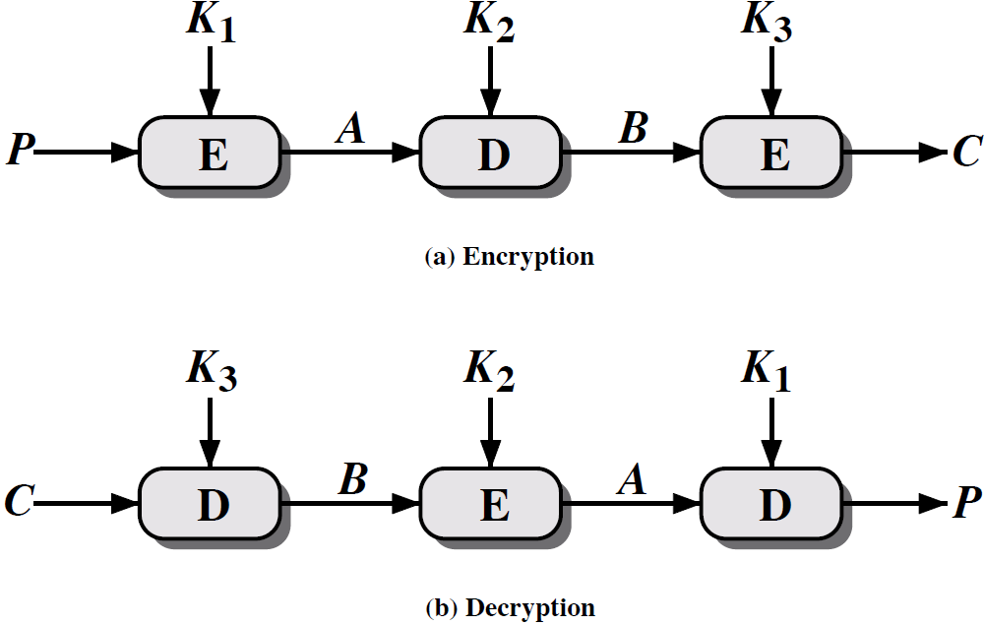
Triple DES…

